Slide 1
Lingvin snakegame
TIMMATES:
MAkhmudov sherzodbek 2016116885
Le xuan huy 2017117323
Wang Jigang 2017116855
Lee Jae ho 2008038063

Slide 2
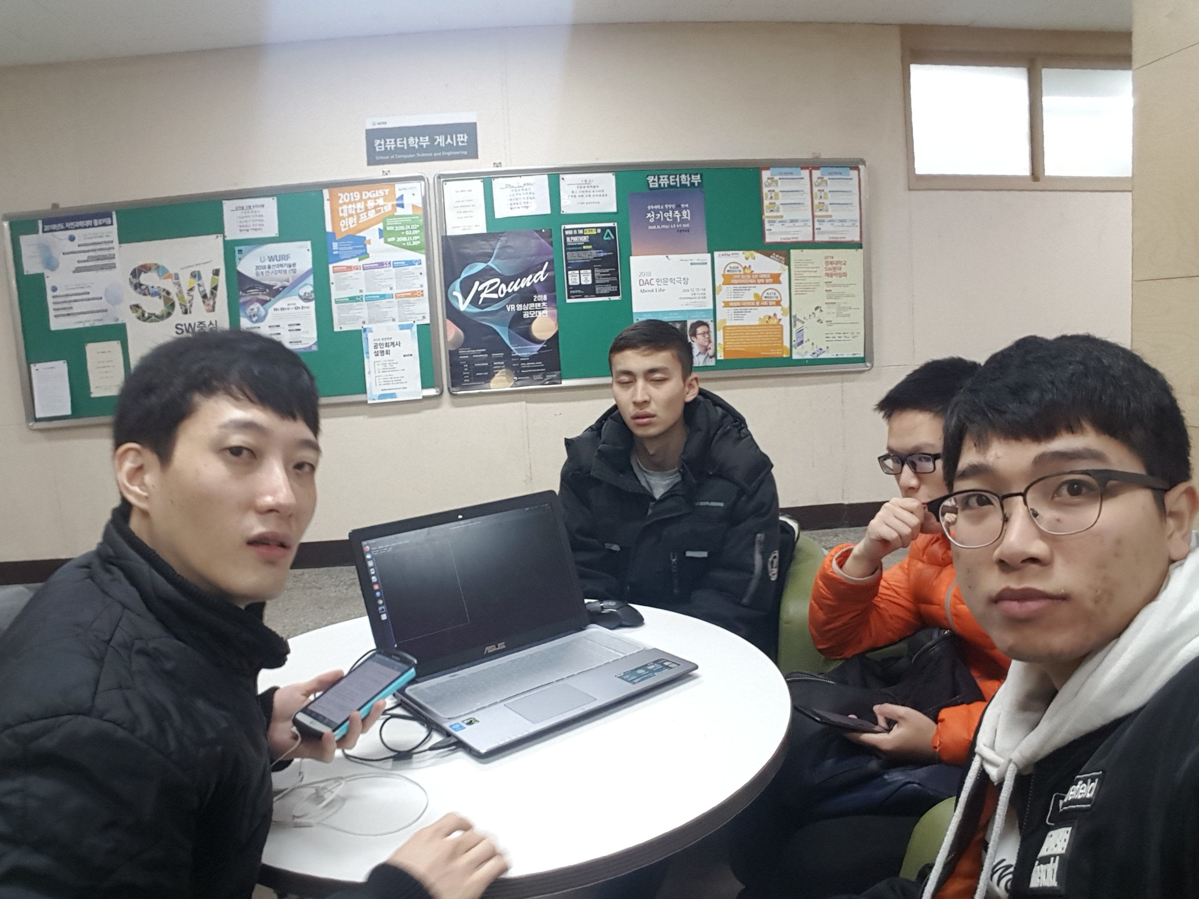
< Team project on ‘Snakes-Multiplayer Intelligent Snake Game’ >
Name | Role | Major
MAkhmudov sherzodbek | Team Leader, making Proposal document, Chief of presentation, Manage Team-works. | Comp.science and Eng
Le xuan huy | Support implement, Project meneger and scheduler. | Comp.science and Eng
Wang Jigang | Support Task, SA, Chief of ppt manager | Comp.science and Eng
Lee Jae ho | - Support Task, Proposal document support, SA, Development lead. | Comp.science and Eng

Slide 3
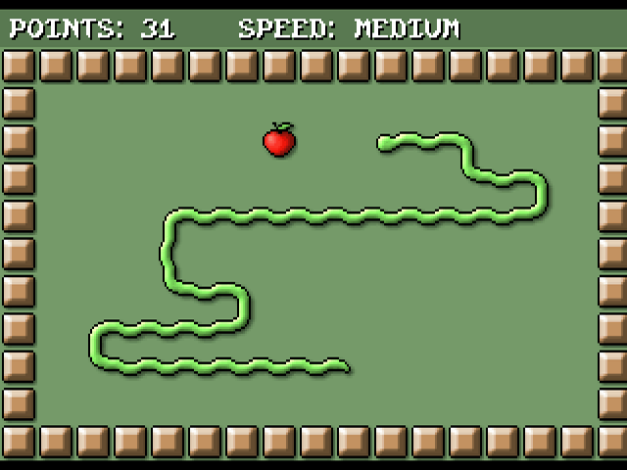
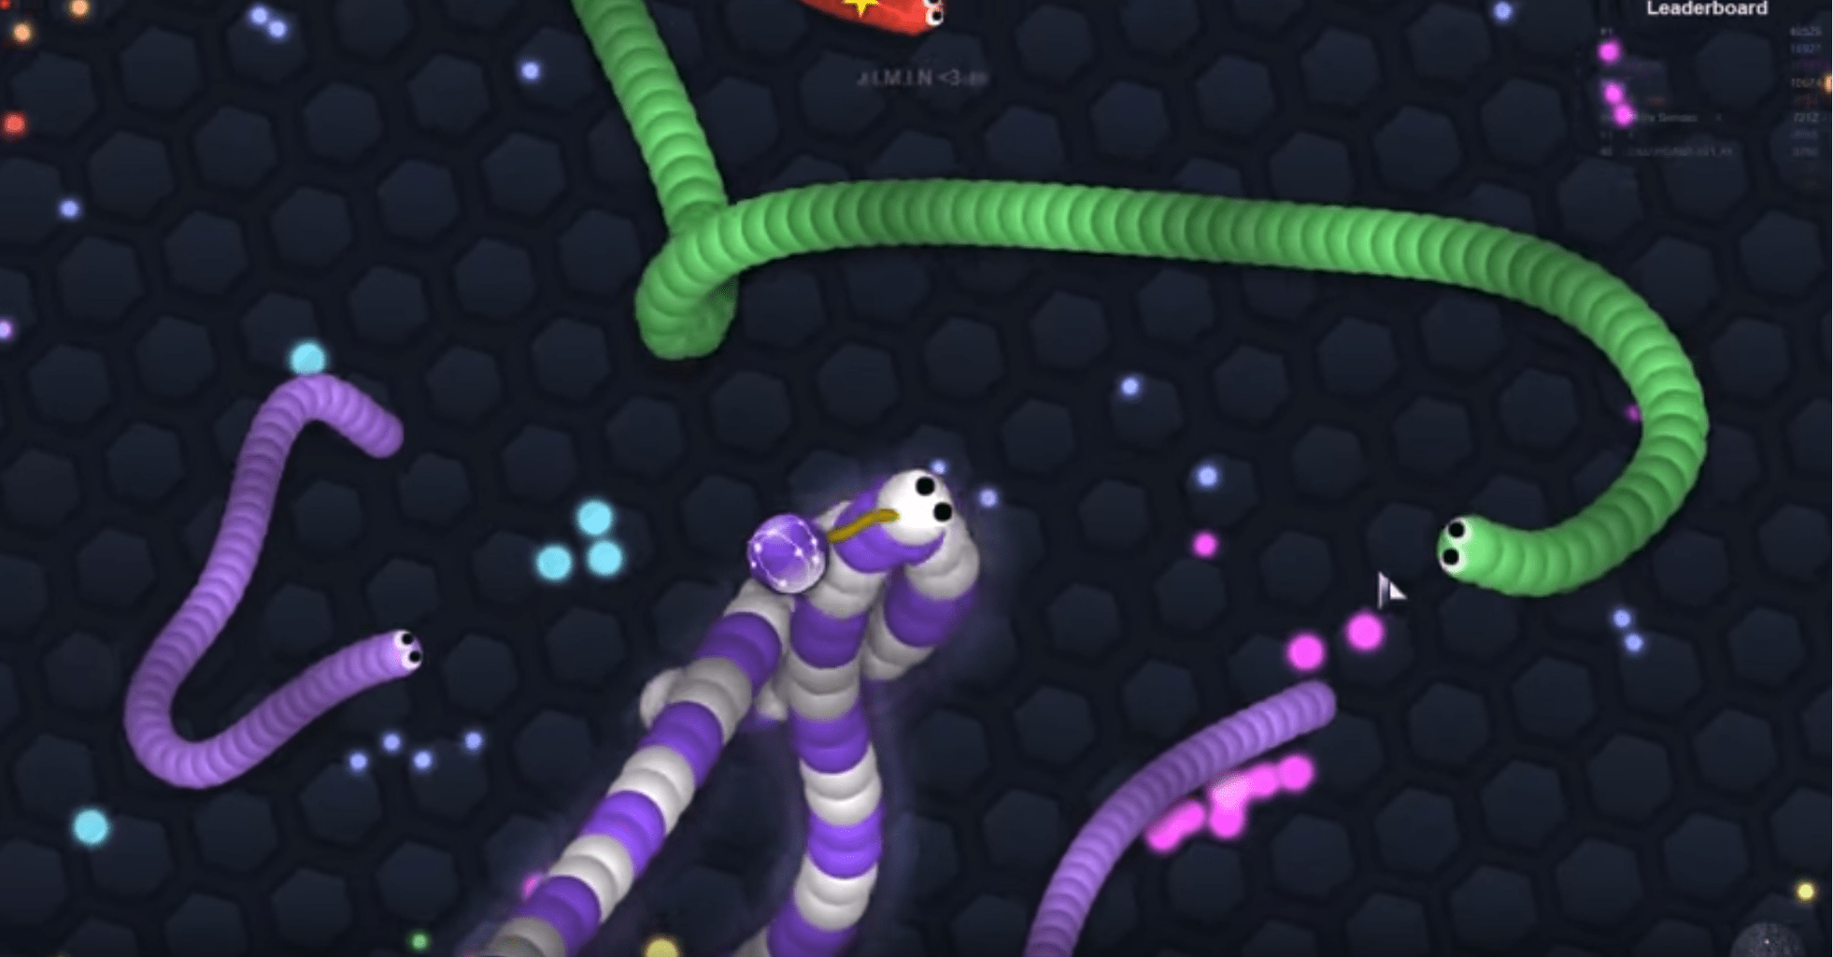
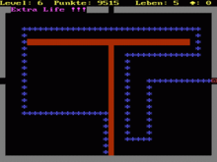
Evolution of snake game
The first snake game from nokia
2006
2018
1997 year

Slide 4


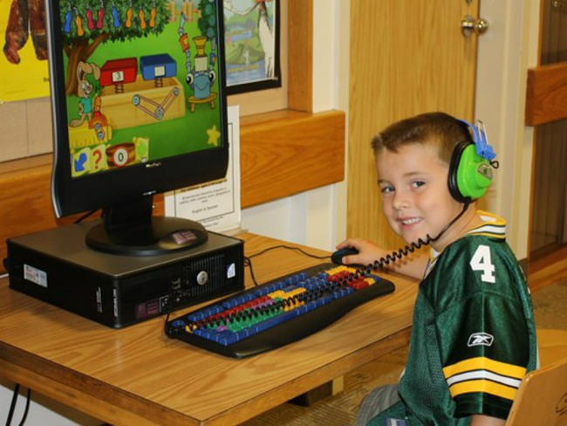



Why snake game?

Slide 5
Run The Game!

Slide 6
Structure of game
Libraries
Functions
Main
void initsnake();
void interface();
void getInput();
void CreatFood();
void creatLink();
void insertNode(int x , int y);
void deleteNode();
void deleteLink();
int set_ticker(int);
void printS_b();
void printrefresh();
void snakeInformation();
void gameover(int i);
#include<stdio.h>
#include <curses.h>
#include <stdlib.h>
#include <malloc.h>
#include <sys/time.h>
#include <unistd.h>
#include <signal.h>
#include <time.h>
int main()
{
initscr();
initsnake();
signal(SIGALRM,printrefresh);
getInput();
endwin();
return 0;
}

Slide 7
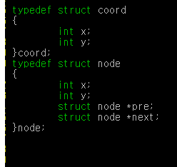
coord
node
x
x
y
y
pre
next

Slide 9
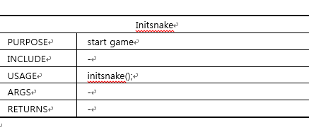
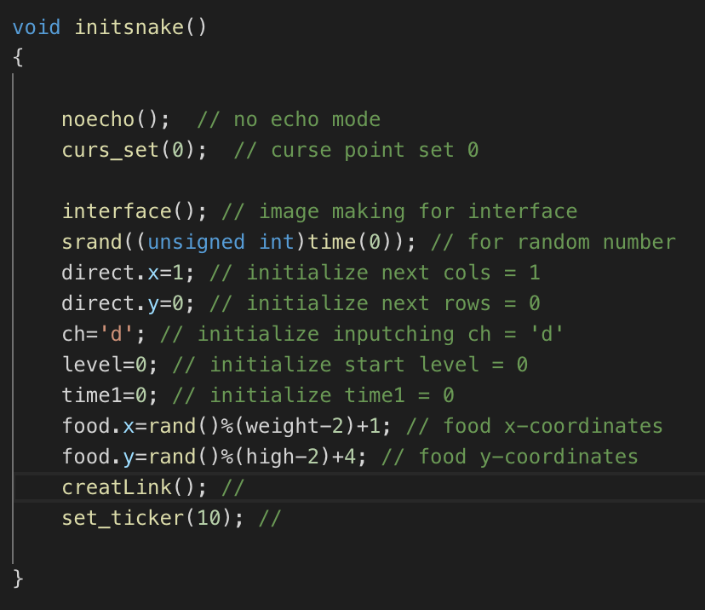

Slide 12


